Slide 1
Kali and ICS Lab Overview
Capacity Building for Control System Security Collaborative Project

Slide 2
Greg Randall
Program Chair Computer Information Systems
Snead State Community College

Slide 3
Outline
Overview the Kali Linux OS
ICS Labs
Overview of Metasploit
Overview of Armitage

Slide 4
Kali Linux
Kali Linux is a Debian-based Linux distribution aimed at advanced Penetration Testing and Security Auditing. Kali contains several hundred tools which are geared towards various information security tasks, such as Penetration Testing, Security research, Computer Forensics and Reverse Engineering.
Kali Linux is developed, funded and maintained by Offensive Security, a leading information security training company. Kali replaced Backtrack as the penetration testing of choice.
Kali Linux is specifically tailored to the needs of penetration testing professionals, and therefore prior knowledge of, and familiarity with, the Linux operating system is assumed.
Source: https://docs.kali.org/introduction/what-is-kali-linux

Slide 5

Kali Linux

Slide 6
ICS Labs
The labs performed in the ICS portion of the workshop require Kali Linux (32bit) and a bootable USB drive
Each lab will require booting to Kali Live Persistence in order to save files, payloads and scripts
The BIOS of the device on which the Kali Live Persistence is booted must support USB booting options
No downloaded applications can be saved between reboots of the USB OS
Complete instructions for making a Live Kali USB bootable device can be found here: https://docs.kali.org/downloading/kali-linux-live-usb-install

Slide 7
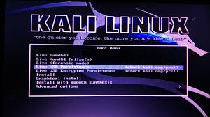
Live USB Persistence Option at Boot

Slide 8
ICS Workshop Labs Overview
Labs for the ICS workshop will consist of 8 labs containing the following topics:
Day 1 Workshop (Thursday)
ICS Lab 1 Hacking a Wireless Network- Overview
ICS Lab 2 Scanning and Enumerating- Overview- How to boot into Kali Linux
ICS Lab 3 Packet Capture and Analysis- Overview- How to boot into Kali Linux
ICS Lab 4 Deep Packet Capture and Analysis

Slide 9
ICS Workshop Labs Overview
Labs for the ICS workshop will consist of the following topics:
Day 2 Workshop (Friday)
ICS Lab 5 Installing Veil-Evasion- Overview
ICS Lab 6 Using Python SimpleHTTPServer- Overview
ICS Lab 7 Exploiting a PLC Using Metasploit
ICS Lab 8 Exploiting an HMI Device Using Armitage

Slide 10
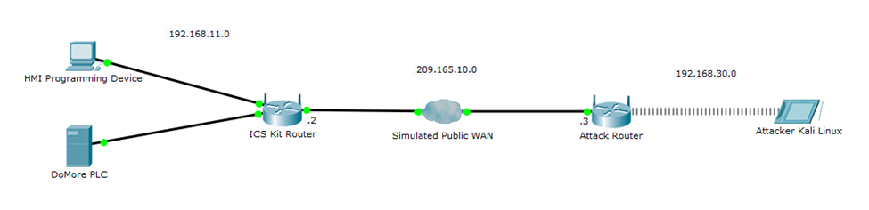
ICS Lab Topology

Slide 11
Metasploit
The Metasploit Project is a computer security project that provides information about security vulnerabilities and aids in penetration testing and IDS signature development.
The Project is contained in the Kali Linux OS and will be used in Day 2 of the Workshop
Source: https://en.wikipedia.org/wiki/Metasploit_Project

Slide 12
Armitage
Armitage is a scriptable red team collaboration tool for Metasploit that visualizes targets (GUI-Based), recommends exploits, and exposes the advanced post-exploitation features in the framework.
Armitage will be used in Day 2 of the Workshop
Source: https://tools.kali.org/exploitation-tools/armitage

Slide 13
Questions??

